Slide 1
Administration Portal
Design - Part 2
Derek Brandt
Tyler Orman
Aryan Rao
Israel Sanchez Tellez
Team ID: sddec24-03
Client: DigiClips
Faculty Advisor: Dr. Ashfaq Khokhar

Slide 2
Agenda
Project Overview
Detailed Design and Visuals
Functionality
Technology Considerations
Areas of Concern and Development

Slide 3
Project Overview

Slide 4
Project Overview
DigiClips is striving to be a website that catalogs diverse media content
including news coverage, advertisements, radio broadcasts, and podcasts.
Our team’s primary objective centers on revitalizing
the administration portal which oversees
users and server status.

Slide 5
Detailed Design and Visuals

Slide 6
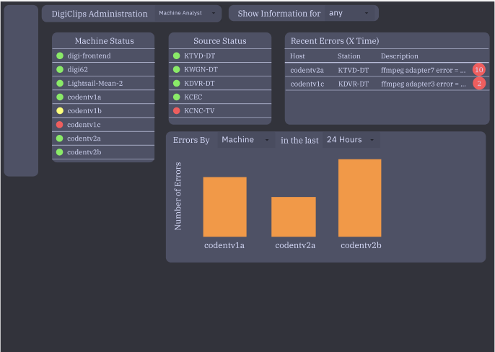
Detailed Design and Visuals
Our design consists of a series of pages where our users can view and interact with various administrative data.
The page to the right shows an example of a home page for a Machine Analyst. The status of various machines can be seen as well as graphics to show error rates. There will also be a menu on the left to take the user to specific pages with more in-depth information.

Slide 7
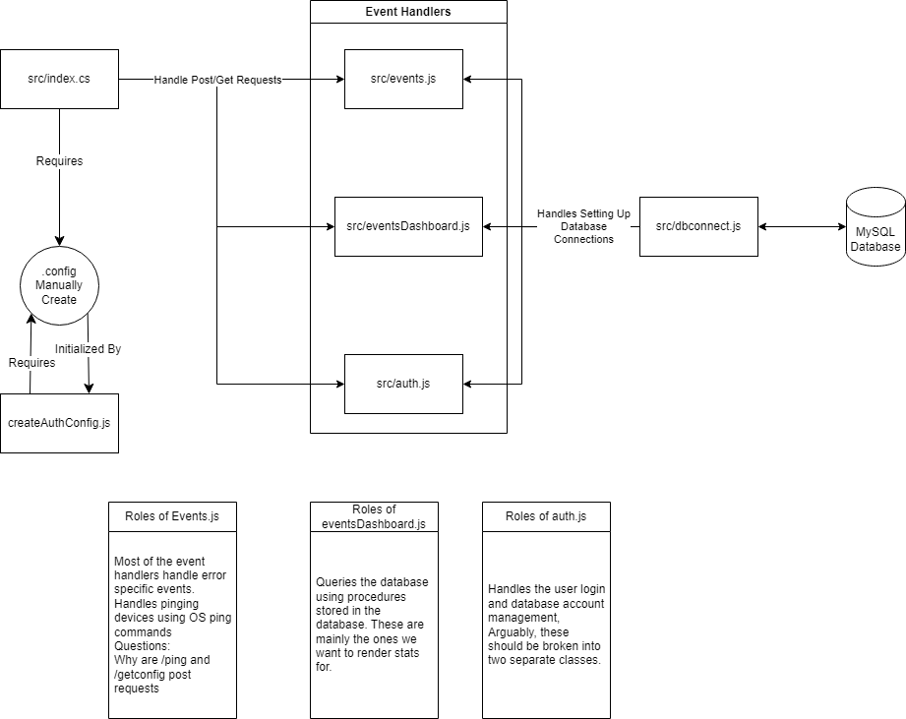
Detailed Design and Visuals
Here is a functional diagram outlining the source code for the backend system of the DigiClips administrative portal. This is an outline of the current functionality of the dashboard the the roles of each section of the system.

Slide 8
Functionality

Slide 9
Functionality
User Actions:
Select user type
Change page
Change table timeframes/metrics
System Responses:
Changes section information based on drop down
Present information based on user type
Customize table data based on selected parameters

Slide 10
Technology Considerations

Slide 11
Technology Considerations
Angular 18.0
Weighed against other options
Clients existing codebase is written in Angular
Clients requested this framework
MySQL
Clients are currently using a MySQL database
Clients requested we continue with this database

Slide 12
Areas of Concern and Development

Slide 13
Areas of Concern and Development
Because our design is modular and there will be a dedicated page for each user role, our current design will be able to satisfy our users needs and adapt with them as the requirements change in the future.

Slide 14
Areas of Concern and Development
Concerns:
Our primary concern is limitations in the Angular framework that may prevent us from implementing our designs.
An addition concern is the number of pages that may need to be designed to have a unique page for each user role.

Slide 15
Questions?

